Slide 1
HPC, HIPAA, and FISMA: Meeting the Regulatory Challenge through Effective Risk Management
Bill Barnett & Anurag Shankar
Pervasive Technology Institute
Center for Applied Cybersecurity Research
Indiana University
2014 NSF Cybersecurity Summit for Large Facilities and Cyberinfrastructure
August 26, 2014

Slide 2
Outline
Introduction
HPC & Compliance at IU: A History
HIPAA & FISMA Demystified
Cyber Risk Management
Building & Leveraging a Risk Management Framework
Conclusions

Slide 3
Schedule
Introduction | 1:00 – 1:05
HPC & Compliance at IU – A History | 1:05 – 1:15
3. A Gentle HIPAA Primer | 1:15 – 1:45
4. A Gentle FISMA Primer | 1:45 – 2:15
5. Cyber Risk Management | 2:15 – 2:30
6. The NIST Risk Management Framework (RMF) | 2:30 – 3:00
Break | 3:00 – 3:10
7. Building the NIST RMF at IU | 3:10 – 3:55
8. Using it to address HIPAA | 3:55 – 4:10
9. Conclusions | 4:10 – 4:20
10. Q&A | 4:20 – 5:00

Slide 4
1. Introduction

Slide 5
HPC & Compliance
With physical scientists and engineers as primary customers, rules and regulations that govern sensitive data were not relevant to HPC.
The introduction of expanding health sciences data has pushed HPC out of this comfort zone.
Suddenly, we find ourselves in a scary & unfamiliar world of regulatory compliance.

Slide 6
The Problem
Analysis, storage, and management of a growing volume of health sciences research data now requires significant compute resources.
It is reaching scales typical of data intensive physical sciences and engineering disciplines.
Medical center IT cannot support projects of this magnitude.
> Users are coming to HPC with clinical data

Slide 7
As cyberinfrastructure leaders managing sensitive Big Data, its about:
Delivering Value – making research happen
Earning Trust – from all our stakeholders
Managing Risk – reimagining security
But it’s really kinda like this…

Slide 8
Photo courtesy Natalie Griffin

Slide 9
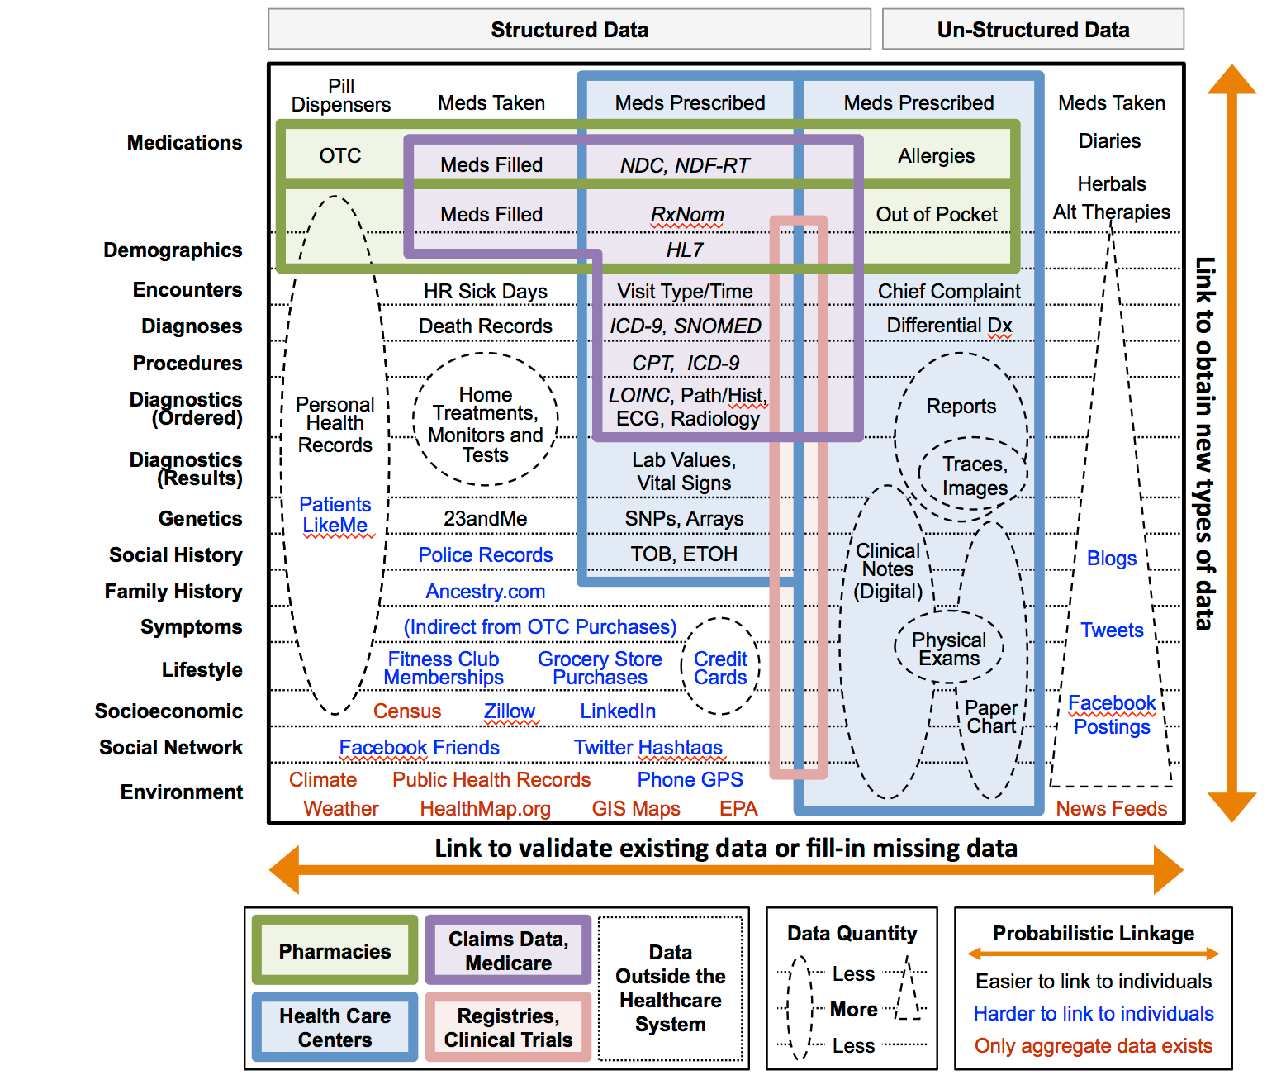
…And This
Weber, Mandl, and Kohane “Finding the Missing Link for Big Biomedical Data” JAMA 2014.4228

Slide 10
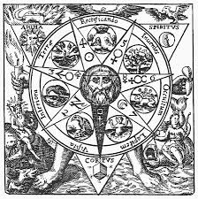
Right now, Big Data is still Alchemy
Omics: new kinds of data with young rules
Patients as Partners: new stakeholders
Network Science: new conceptual modes
Team Science: competitions (Sage/DREAM)
Crowd Sourcing: public analysis
Cloud: new data sharing capabilities
Source: Steven Friend, Bio-IT World keynote presentation, April 30, 2014

Slide 11
Compliance Facts
Clinical research data are subject to HIPAA.
FISMA is required in govt. grants & contracts.
IRB’s/Research Administrators/Researchers are neither IT nor regulatory experts so that IT safeguards often do not get addressed as required by government regulations.
→ Breaches & fines

Slide 12
The Regulatory Challenge
Regulations such as HIPAA & FISMA have their own, specific requirements and stress different areas.
HPC shops lack regulatory expertise.
HIPAA fines have increased substantially.
The government (OCR) has initiated random HIPAA audits in 2014 (Audits occurred only as part of data breach investigations earlier).

Slide 13
No Plausible Deniability
The service must be HIPAA aligned if even a single clinical researcher has an account on the system.
There is no plausible deniability in HIPAA. It says that you should have expected that allowing clinical researchers on the system will lead to clinical data on the system.

Slide 14
2. HPC and Compliance at IU: A History

Slide 15
IU’s HPC Organization
Indiana University (IU) has provided mature HPC services for many years.
They are delivered through the Research Technologies (RT) division of the University Information Technology Services (UITS), part of the Pervasive Technology Institute
RT provides supercomputing, data storage/archival, visualization, application development and optimization, data management, and other services.

Slide 16
HIPAA History
IU’s research cyberinfrastructure, like elsewhere, was used mostly by physical scientists and engineers prior to 2000.
A Lilly Endowment grant accelerated genomics research at IU & established need for HPC services for the IU School of Medicine.
> There was initially no uptake in HPC

Slide 17
Contributing Factors
Researchers would not de-identify data (#1 reason for lack of user interest)
A mismatch between HPC & medical culture
Our lack of regulatory expertise and practice
A lack of resources to address 2 & 3

Slide 18
Timeline
Our HIPAA efforts began in 2007.
An institution-wide committee for oversight and advocacy.
An external consultant for gap and risk assessment.
The project received dedicated resources in 2008.
Adopted NIST 800-53 as the security standard
IU Compliance finally deemed us capable of ‘sufficiently protecting ‘ research ePHI in 2009.
Now moving to FISMA framework for broader application

Slide 19
HIPAA Implementation Steps
1. Assign ownership
2. Form partnerships
3. Document everything
4. Hire external consultant
5. Perform gap analysis/fill gaps
6. Assess risk
7. Create & execute risk management plan
8. Get official blessing & advertise

Slide 20
Steps
Assign ownership: One RT director and one staff (about 1 FTE)
Form partnerships: Put all stakeholders on an oversight committee.
Document everything: Policies & procedures, responsibilities
Hire external consultant: Recommended by IU Compliance
Perform gap analysis: Measured how far we are from HIPAA
Fill gaps: Plugged as many holes as we could
Assess risk: Output from 3&5 informed the assessment
Create & execute risk management plan: Guided by consultant
Get official blessing & advertise: Focus on biomedical researchers

Slide 21
Measures of Success
Starting from zero in 2009, we now have:
Number of biomedical user accounts | 3,000
Volume of biomedical data stored | ~1PB
3. Use of computing cycles | 1 MSUs
4. Number of databases | > 800
5. New services for biomedical users | >10
6. Number of NIH grants that fund us | 5
7. Number of FTEs funded by these grants | ~ 10

Slide 22
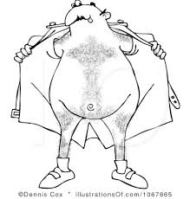
3. HIPAA & FISMA DEMYSTIFIED
HIPAA
FISMA

Slide 23
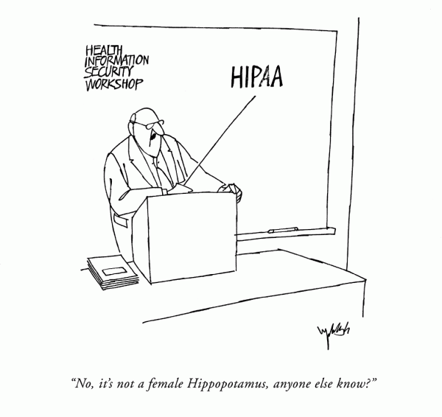
HIPAA

Slide 24
A Gentle HIPAA Primer
Health Insurance Portability & Accountability Act.
Passed in 1996, became law in 2001.
Enforced by the Office for Civil Rights (OCR) in the US Dept. of Health & Human Services (DHHS).
The Omnibus Final Rule of 2013 includes provisions from the 2006 Health Information Technology for Economic & Clinical Health (HITECH) Act & the 2008 Genetic Information Nondiscrimination Act (GINA).

Slide 25
Patient Privacy Protection
Addressed via the HIPAA Privacy Rule and the HIPAA Security Rule.
The Privacy Rule defines who HIPAA applies to (covered entities), what is protected (protected health information or PHI), and covers disclosure.
The Security Rule focuses exclusively on how to protect electronic PHI (ePHI) in any form – at rest, in transit, under analysis, etc.
→ ePHI = identifiable patient data with any of 18 identifiers

Slide 26
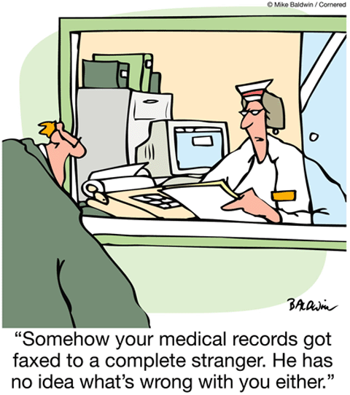

Slide 27
Identifiers that Make Data PHI
Names
All geographic subdivisions smaller than a state, including street address, city, county, precinct, zip code, and their equivalent geocodes, except for the initial three digits of a zip code if, according to the current publicly available data from the Bureau of the Census: (1) the geographic unit formed by combining all zip codes with the same three initial digits contains more than 20,000 people; and (2) the initial three digits of a zip code for all such geographic units containing 20,000 or fewer people is changed to 000.
All elements of dates (except year) for dates directly related to an individual, including birth date, admission date, discharge date, date of death; and all ages over 89 and all elements of dates (including year) indicative of such age, except that such ages and elements may be aggregated into a single category of age 90 or older.
Telephone numbers
Fax numbers
Electronic mail addresses
Social Security numbers
Medical record numbers
Health plan beneficiary numbers
Account numbers
Certificate/license numbers
Vehicle identifiers and serial numbers, including license plate numbers
PHI, when properly de-identified, is no longer PHI
Device identifiers and serial numbers
Web universal resource locators (URLs)
Internet protocol (IP) address numbers
Biometric identifiers, including finger and voice prints
Full face photographic images and any comparable images
Any other unique identifying number, characteristic or code

Slide 28
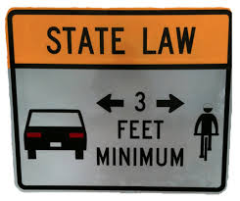
Relationship to State Laws
Many states have their own privacy laws.
If HIPAA is incompatible with state laws, HIPAA preempts state.
Except when the state law provides greater privacy protections than HIPAA.
DHHS makes the determination upon request.
HIPAA is a floor, not a ceiling.

Slide 29
Covered Entity
HIPAA applies to a covered entity (CE).
A covered entity is a healthcare provider, a health plan or a health clearinghouse.
Universities often choose to be hybrid covered entities, with both non-covered and covered components.
All HIPAA related issues affect the whole CE. (For instance, the CE faces fines when a HIPAA violation occurs, not an individual.)

Slide 30
Am I covered?
Your organization (say HPC Center) is not a covered entity if you are not involved in healthcare operations directly.
However, it is still subject to HIPAA if both of the following are true:
you serve a covered entity, either as a unit of your covered entity or as a Business Associate, and
if you handle ePHI in any way, shape, or form.
So you cannot say “I didn’t know we had ePHI”.

Slide 31
Business Associates
A HIPAA Business Associate (BA) is defined as “a person or organization, other than a member of a covered entity's workforce, that performs certain functions or activities on behalf of, or provides certain services to, a covered entity that involve the use or disclosure of individually identifiable health information.”

Slide 32
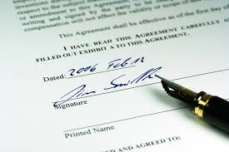
Business Associate Agreements
HIPAA requires a Business Associate Agreement (BAA) with BAs that can touch ePHI on your system (since it’s a disclosure).
The BAA must include language that the BA will protect your ePHI and abide by HIPAA. (Sample BAAs at DHHS site.)
You must do due diligence (an assessment) to ensure that the BA can protect your ePHI as per HIPAA.

Slide 33
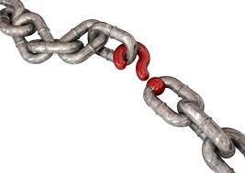
Am I a Business Associate?
You are not a BA if you are part of say a university and provide services to its medical school or other covered components.
You are if you provide services to an an external covered entity. Then the CE must have a HIPAA BAA with you (since your sys admins have access to their user data/ePHI).
They are in violation of HIPAA if they do not.

Slide 34
Recent HIPAA Changes
The HIPAA Omnibus Final Rule added HITECH & GINA provisions, new business associate & breach notification requirements, and audits/enforcement.
HITECH was part of ARRA and enacted to promote the adoption of Health Information Technology, especially Electronic Health Records (EHR).
GINA prohibits insurers from using human genetic data to deny coverage based on genetic predisposition to future diseases. However, genetic data without the 18 identifiers is not subject to HIPAA.

Slide 35
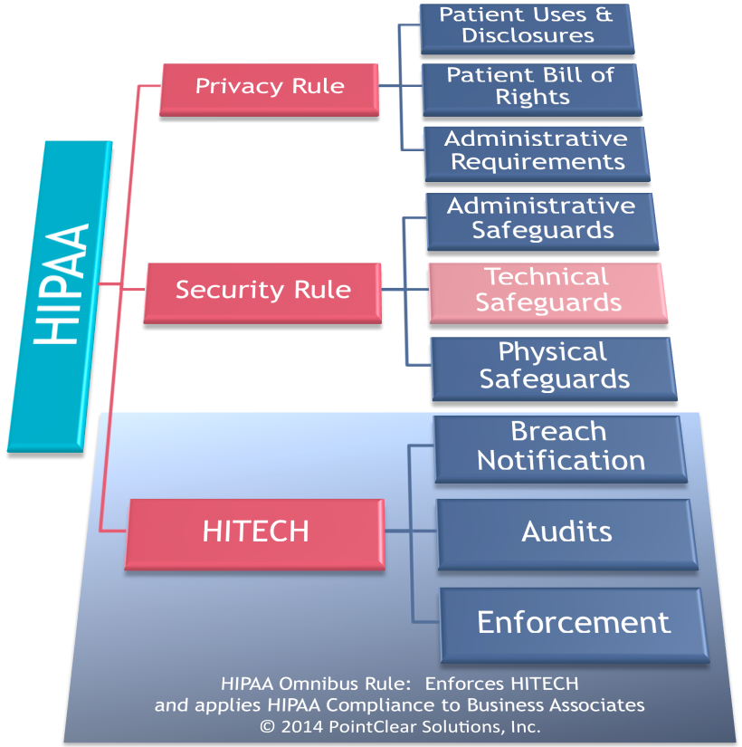
HIPAA after Omnibus
Courtsey Pointclear Solutions, Inc.

Slide 36
Are genetic data ePHI?
NO, so long as it is not tied to a person using one of the 18 identifiers. This is true even though it is possible in principle to identify a person using unidentified genetic data alone.
However, the risk is low since such identification is no easy task.
Note that rules governing human subjects still apply.
Keep monitoring the legal landscape for changes.

Slide 37
Breach Notification
HIPAA requires that a breach of ePHI be reported to the OCR & those affected within 60 days.
For breaches involving > 500 individuals, local media outlets must also be notified.
You must use your local IT incident reporting mechanism to create an official record of your response for audit purposes.

Slide 38
Enforcement
HIPAA is enforced by the Office for Civil Rights (OCR) in the Dept. of Health & Human Services (DHHS).
Violations can result in civil monetary penalties (up to $1.5 million) against a covered entity and/or individual criminal penalties (imprisonment up to 10 years).
The OCR was funded via ARRA/HITECH to institute an audit program. They have done 150 audits already and getting ready for more.

Slide 39
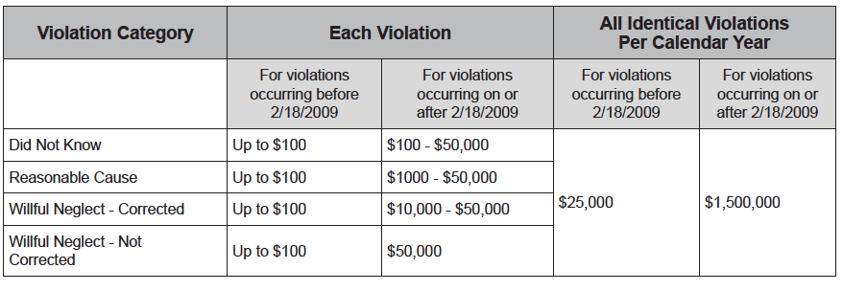
Civil Monetary Penalties
*
* = An act of omission in which a covered entity or business associate knew, or by exercising reasonable diligence would have known, that the act or omission violated an administrative simplification (HIPAA) provision, but in which the covered entity or business associate did not act with willful neglect.
The cost of “I didn’t know we had ePHI”.
Notes:
ANIMATION

Slide 40
Wonders of Multiplication
HIPAA penalties are levied per violation.
Breach of an individual record is one violation. To calculate your total, multiply by the number of affected individuals.
Fortunately, there are maximums. Still, these are serious numbers.
The worst hit you take is not the penalty but damage to the institution’s reputation.

Slide 41
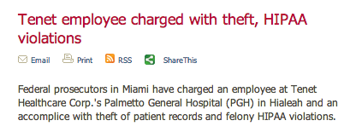
HIPAA Civil/Criminal Penalties in Action

Slide 42
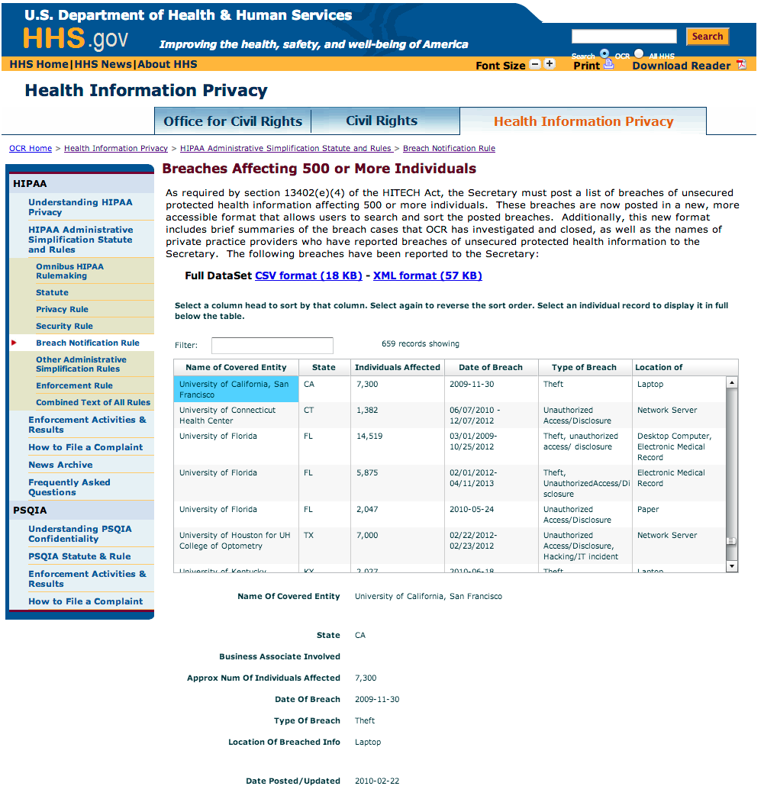
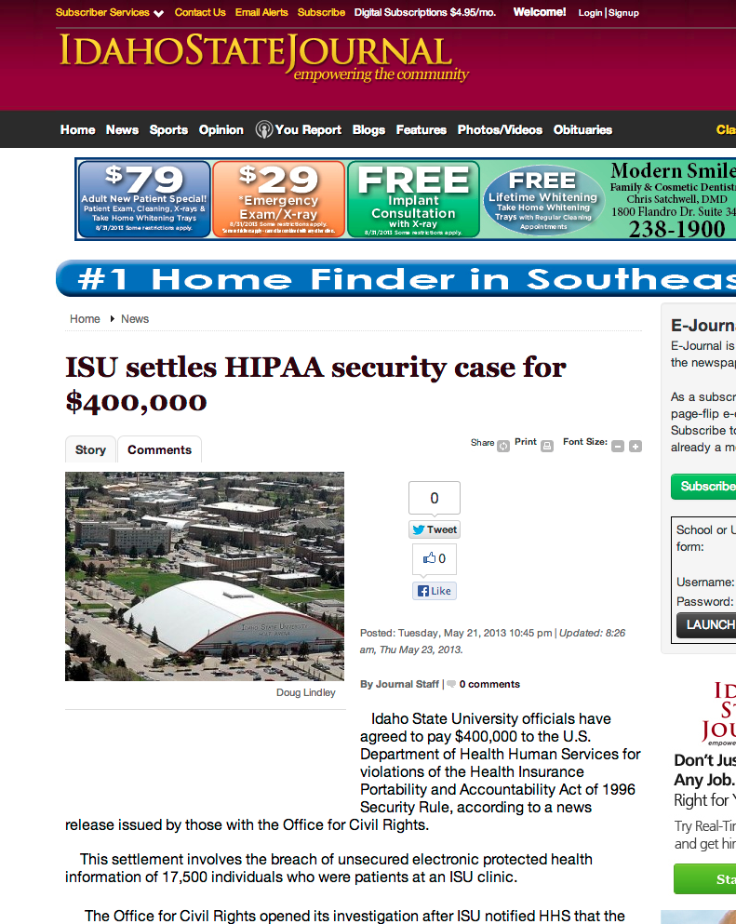
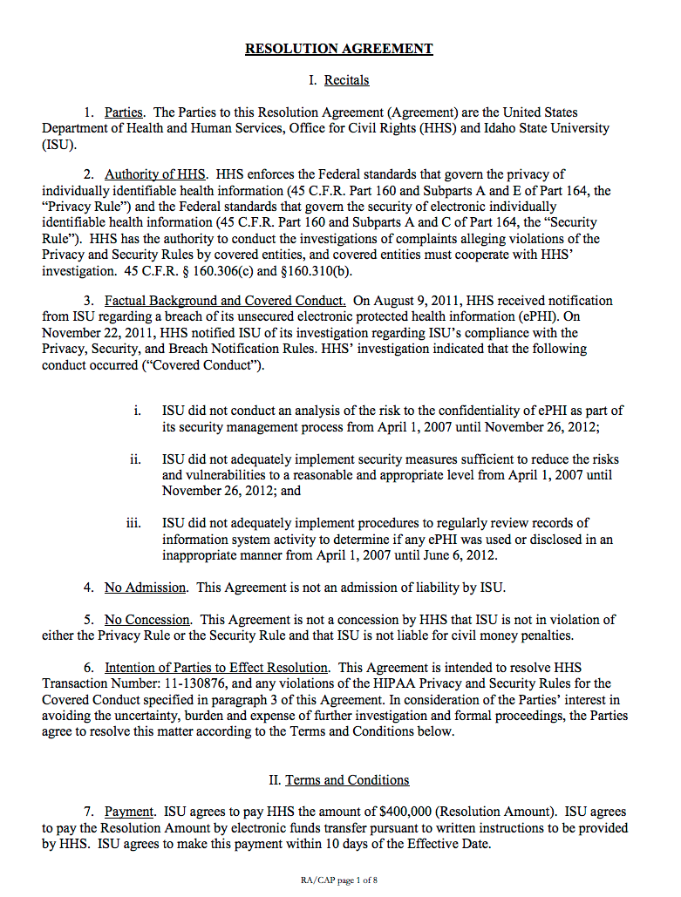
Corrective Action Plan for ISU
The Corrective Action Plan (CAP)
signed by Idaho State University

Breaches reported by universities
The absolute worst is being in the newspapers!

Slide 43
What happens after a breach?
The OCR, affected individuals, and/or media are notified.
All documentation (incident response, policies & procedures, risk assessment, management, etc.) is submitted to OCR.
OCR may open an investigation or bless due diligence if response is swift and addresses underlying risks.
Or it may require a “Corrective Action Plan” (CAP) and levy a fine.
If appropriate, a CAP response is submitted to OCR.
OCR closes the investigation.

Slide 44
Breach Investigation
During an investigation, the OCR looks for
Documented Policies & Procedures
Implementation of Policies & Procedures
Internal investigation reports, interview statements, etc.
Appropriate sanctions applied
Documented Training
Business Associate Agreements
Documented Risk assessment, mitigation
Encryption & mobile device policies/implementation

Slide 45
Protecting ePHI: The HIPAA Security Rule

Slide 46
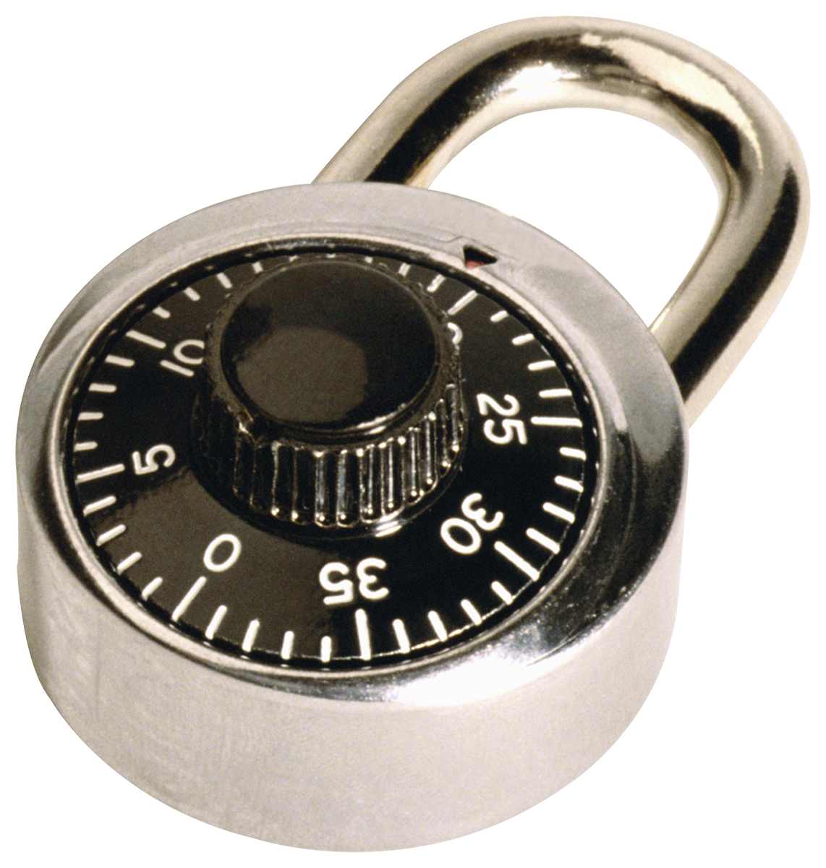
The HIPAA Security Rule
The Security Rule requires 1. Administrative, 2. Physical, and 3. Technical safeguards to
Ensure the confidentiality, integrity, and availability of all ePHI created, received, maintained or transmitted;
Identify and protect against reasonably anticipated threats to the security or integrity of the information;
Protect against reasonably anticipated, impermissible uses or disclosures;
Ensure compliance by the workforce; and
Provide a means for managing risk in an ongoing fashion.

Slide 47
Security Rule Safeguards
Administrative – security management/officer, workforce security, access management, incident response, disaster planning, evaluations, etc.
Physical – facilities access, workstation use/security, device/media controls.
Technical – access/audit control, integrity, authentication, transmission security.
+ organizational/policies/documentation requirements

Slide 48
Required & Addressable
Each Security Rule safeguard is either required or addressable.
Required = what it says.
Addressable = should address, but ok if you describe why it is not in place or how you will otherwise address the risk.
A risk assessment (RA) identifies where to concentrate your HIPAA effort.

Slide 49
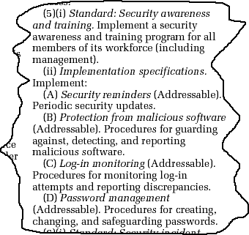
Standards and Implementation
The Security Rule defines a standard and specifies its implementation specifications.
Standards address broad categories.
Implementation specifications are just what it says; how they are to be implemented.
It’s the implementation specifications that are either required or addressable.

Slide 50
Does HIPAA apply to all Identifiable Health Data?
NO. Only healthcare providers, facilities, and insurers are bound by HIPAA. Identifiable health data outside of a healthcare context is not ePHI.
Data, if properly de-identified, is not subject to HIPAA.
→ If unsure, contact your HIPAA Compliance office.

Slide 51
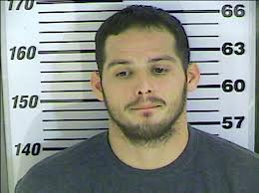
Who is HIPAA implicated in my organization?
Employees, healthcare providers, trainees & volunteers at the medical school and affiliated healthcare sites or programs.
Employees who work with university health plans.
Employees who provide financial, legal, business, administrative, or IT support to the above.

Slide 52
Just Good Security?
Q: So, the HIPAA Security Rule means we just need to provide good IT security for systems?
A: NO. The Security Rule is about managing risk, and security is only PART of that management. HIPAA requires administrative controls, training, governance, policies, formal review, etc.

Slide 53
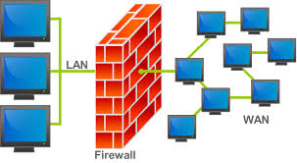
Do I firewall & encrypt it all?
MAYBE. The Security Rule does not prescribe particular solutions or specifications, only broad guidelines, to be interpreted by individual implementers according to their environments.
It requires a managed risk approach that proves due and ongoing diligence.
Documentation is key. If it is not documented IN DETAIL, it doesn’t exist as far as OCR is concerned.

Slide 54
Encryption & Safe Harbor
Encryption is not a required HIPAA Security Rule safeguard.
However, it is highly recommended, both in transit and at rest.
If the data is encrypted at rest and the encryption key is stored separately from the data, a breach need not be reported to the OCR.
This is called “safe harbor”.

Slide 55
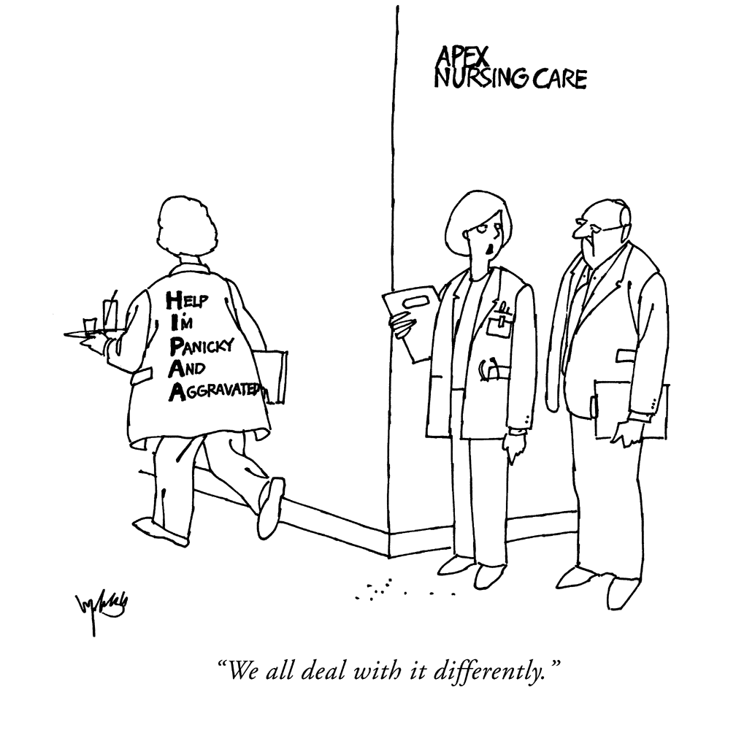
Local Risk Tolerance
Since HIPAA gives such wide berth, it is typically your institutional risk tolerance that in reality determines what you must do.
Some build walled gardens; we didn’t.
Instead, we had our HIPAA Privacy and Security Officers oversee the establishment of a risk management process.
We/they feel that we do sufficient due diligence and can survive an audit.

Slide 56
What exactly is HIPAA Security Rule Compliance?

Slide 57
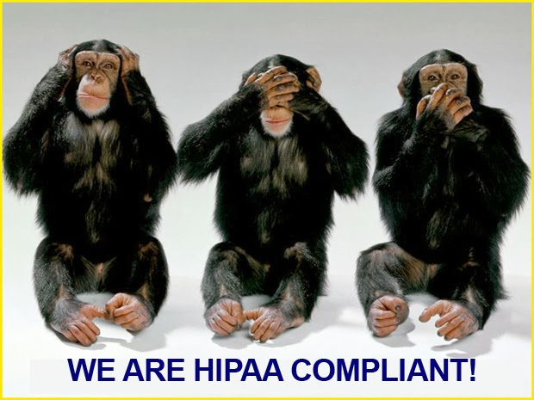
Ideal Situation
Unfortunately, this is not too practical – information needs sharing to be useful

Slide 58
Typical Presumptions
That HIPAA compliance is a boolean = there is a threshold which, when crossed, make you compliant.
That you can have a qualified third party review your environment and certify your HIPAA compliance.
That the whole compliance exercise is a one time deal.
Notes:
ANIMATION

Slide 59
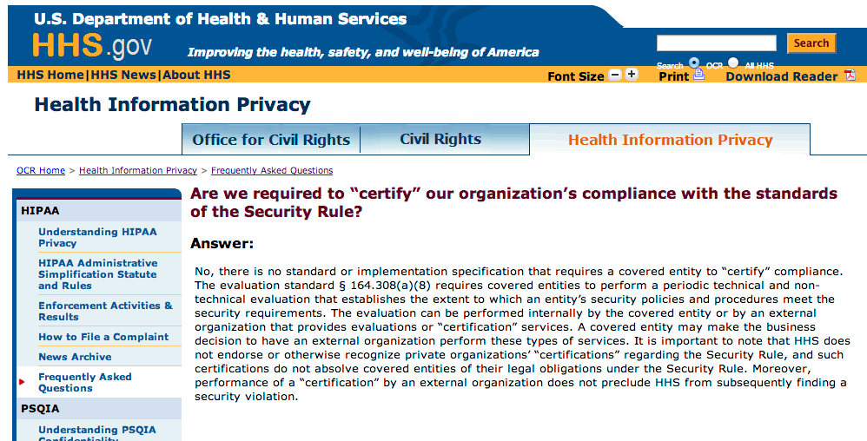
Here is what the DHHS says:
You can only establish the extent to which you are compliant.
We therefore use the word “aligned” rather than “compliant”.
Notes:
ANIMATION

Slide 60
HIPAA Compliance Facts
There is nothing that assures that you are 100% compliant. The OCR may still find you lacking.
Except for one way - an OCR audit ! This however is really not a choice. Due diligence is easier..
So you read the Security Rule carefully, do your best to implement the requisite administrative, physical, and technical safeguards, and self-assert compliance.

Slide 61
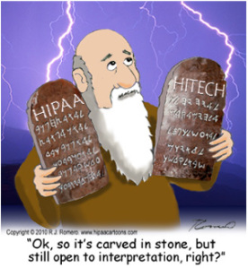
The Boon and Bane of HIPAA
HIPAA Security Rule is wonderfully broad and flexible. Unfortunately, this greatly frustrates IT folks who first encounter it because they can’t figure out exactly what is required of them.

Slide 62
The HIPAA Security Rule Fundamentals
Risk Analysis
Risk Management
Sanctions Policy
Information System Activity Review

Slide 63
HIPAA Security Rule Process
There are many ways to do HIPAA, based on your environment, budget, and risk tolerance.
Your local HIPAA Compliance or Information Security folks may already have a process in place so check with them first.
Instead of covering details here, we’ll illustrate it later using a standards based risk management approach.

Slide 64
Some HIPAA Stats

Slide 65
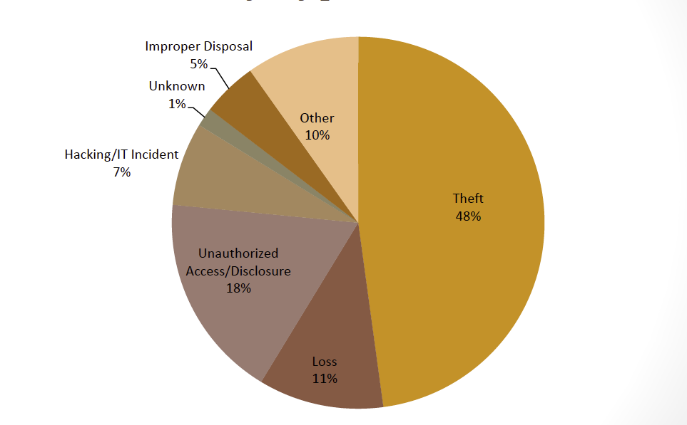
Breach Notification Stats as of 2/14: 500+ Breaches by Type
Courtsey Linda Sanchez, OCR

Slide 66
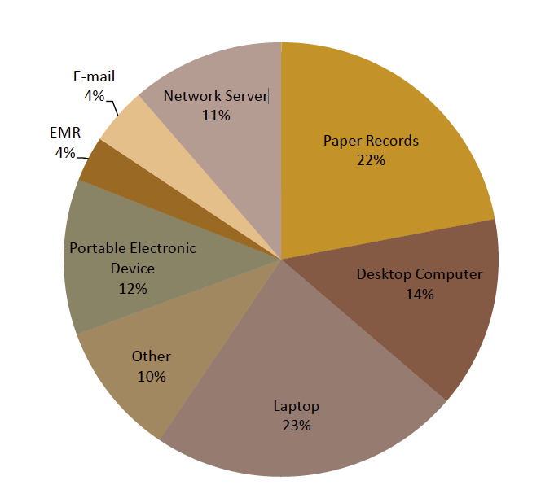
Breach Notification Stats as of 2/14: 500+ Breaches by Location
Courtsey Linda Sanchez, OCR

Slide 67
Lessons from Breaches
Most of the breaches occur due to theft/loss & improper disclosure.
Hacking or IT incidents is only at 7%. However, even one breach at our end is too many since it can be highly damaging to the CE.
A lot of breaches occur at the user end & have to do with (unencrypted) mobile devices. Paper records are still big.

Slide 68
Top Areas of Weakness Revealed by Breach Stats
User Activity Monitoring
Contingency Planning
Authentication and Integrity
Media Reuse and Destruction
Risk Assessments
Granting or Modifying Access

Slide 69
Lessons from Recent OCR Audits
No risk assessments
Improper media movement and disposal
No/inadequate audit controls and monitoring

Slide 70
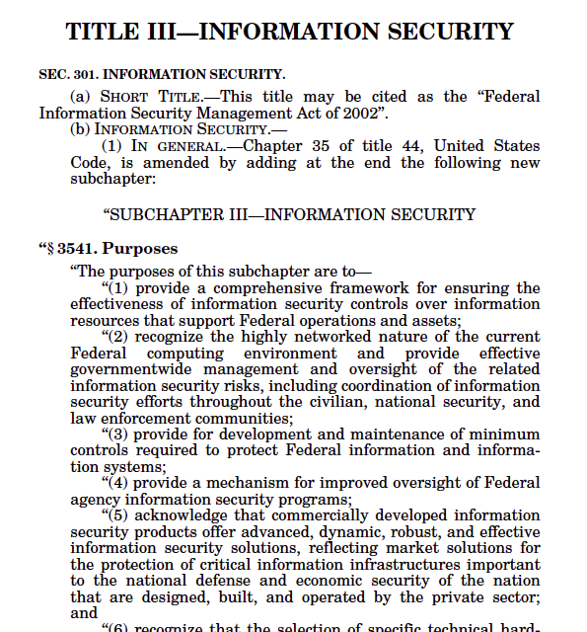
FISMA

Slide 71
A Gentle FISMA Primer
Federal Information Security Management Act of 2002
“Each federal agency shall develop, document, and implement an agency wide information security program to provide information security for the information and information systems that support the operations and assets of the agency, including those provided or managed by another agency, contractor, or other source …”

Slide 72
FISMA Requirements
All government agencies must secure their system as per NIST guidelines.
Universities accepting government contracts must also comply (similar to the HIPAA BA rule).
In fact, grants & contracts are already beginning to include FISMA language, especially from NIH.
→ It is time to start getting ready.

Slide 73
When does FISMA Apply?
When you use your systems to collect or maintain information on behalf of the agency (e.g. for a grant or contract).
When you use or operate information systems on behalf of the agency (e.g. a cloud provider).
The contract or grant will explicitly state FISMA terms. If not, count your lucky stars.
New FISMA language may be added to existing contracts so be sure to check that too.

Slide 74
FISMA is hard!
FISMA will require a budget.
You will need FTEs to handle FISMA.
You will need to create an administrative process.
You may have to create a FISMA walled garden.
You will need patience.
However, it is often possible to negotiate things to something acceptable to both sides.

Slide 75
The FISMA Process
Starts with FISMA language in a grant/contract.
Triggers a local administrative process.
Requires appropriate (NIST) documentation.
The local administrative unit submits FISMA paperwork to the agency.
The agency responds.
Remediation may be required and more paperwork submitted.
The agency issues an “Authority to Operate” (ATO) the system.

Slide 76
Local Administrative Process
Grants Administrators/Business Development
- Identify and notify Research Administration of FISMA terms in contract
- Make sure the budget includes FISMA costs
- Identify and document key IT security personnel
- Make sure all documents that are referenced are included
PI/Study Team
- Clearly describe the scope of work
- Identify all potential subcontractors and their scope of work
PI/Study Team and IT Team
- Identify authorization boundary
- Apply NIST RMF

Slide 77
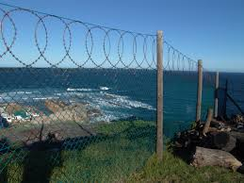
FISMA Authorization Boundary
Also known as the “accreditation boundary”.
Defines where the system begins and ends.
A system can be a part of a network, an application, a logically connected collection of disparate components , etc.
The authorization boundary extends to all direct and indirect users of the system that receive output.
Requires IT professionals to identify.

Slide 78
Real Life Academic Implementations
IU does not have a formal FISMA process in place yet. We’re doing case studies at other institutions.
Of particular interest is Duke Medicine which has a relatively robust FISMA process.
They have built an IaaS based, external FISMA hosting environment.
But, FISMA burdens are such that Duke won’t accept FISMA High contracts.

Slide 79
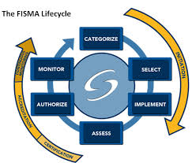
What it takes to FISMA
Duke estimates that, for each contract, it takes them 23-25 hours to review all documentation, make suggested contractual changes for agency negotiation, and create a FISMA management plan.
To handle FISMA, you must first learn NIST and be ready to negotiate.
If you don’t have a FISMA implementation, don’t accept FISMA contracts or talk to the agency.

Slide 80
FISMA Fines?
Unlike HIPAA, which is enforced via civil monetary penalties, FISMA does not have a defined sanction structure.
Federal agencies are penalized through censure by congress, public scorn, and reduced funding.
The worst for university grants & contracts is that you will lose the contract and/or won’t get any new ones.

Slide 81
FISMA Reporting
Unlike HIPAA, FISMA requires quarterly and annual reports to the agency.
It includes reporting
updates to the system security plan to reflect the proposed or actual changes to the information
updates to the plan of action and milestones based on the activities carried out during the continuous monitoring phase
the security status of the information system.

Slide 82
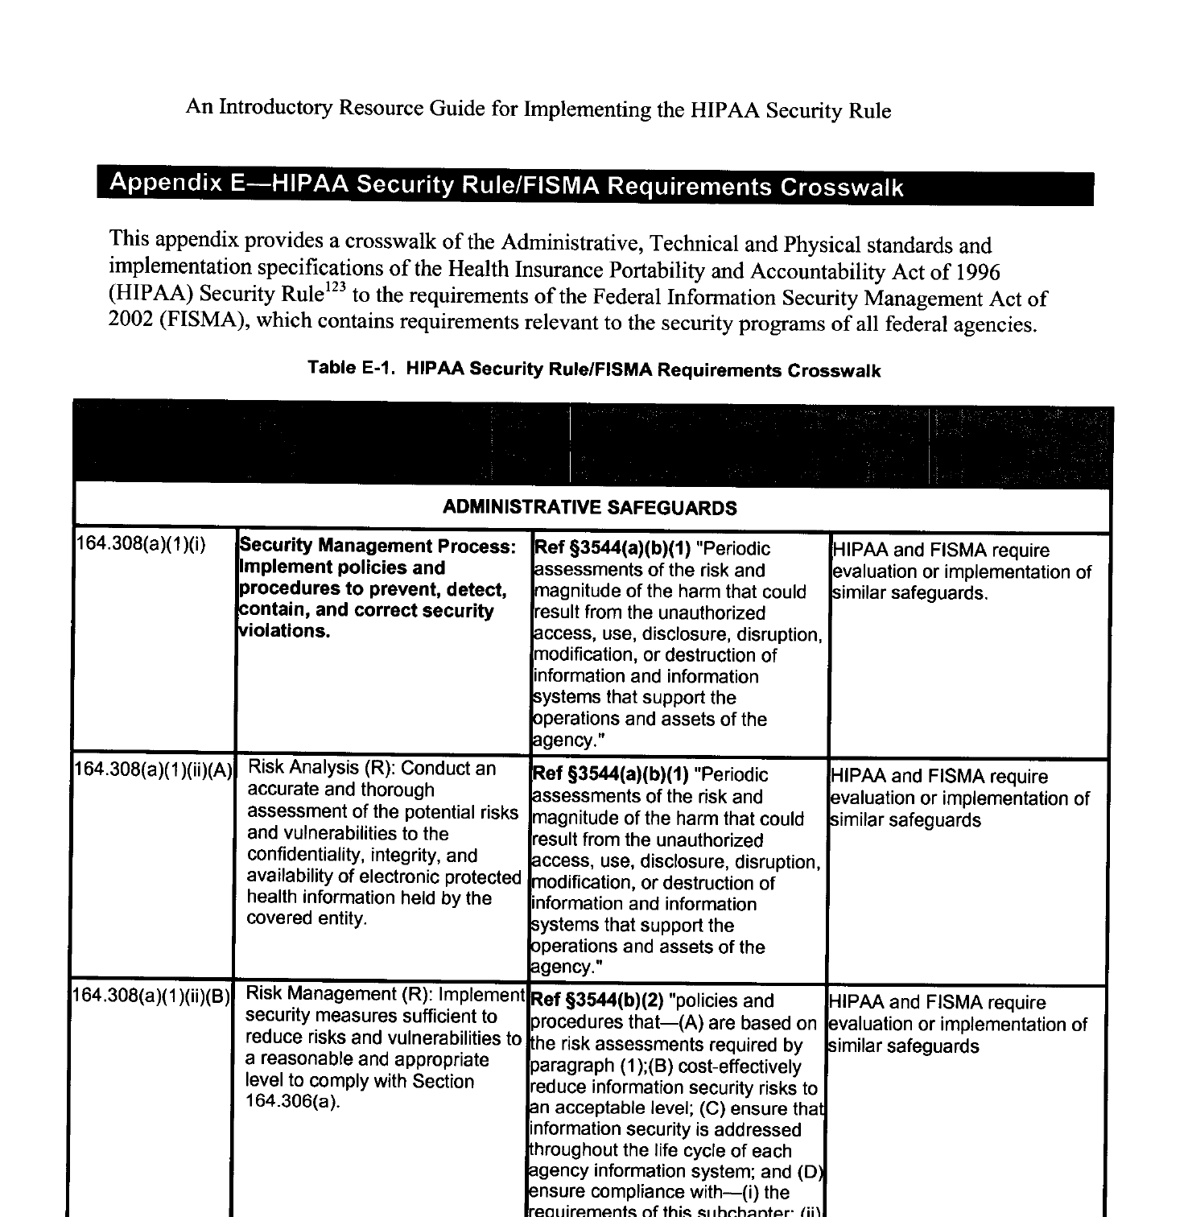
There’s even a HIPAA to FISMA Crosswalk

Slide 83
4. Cyber Risk Management

Slide 84
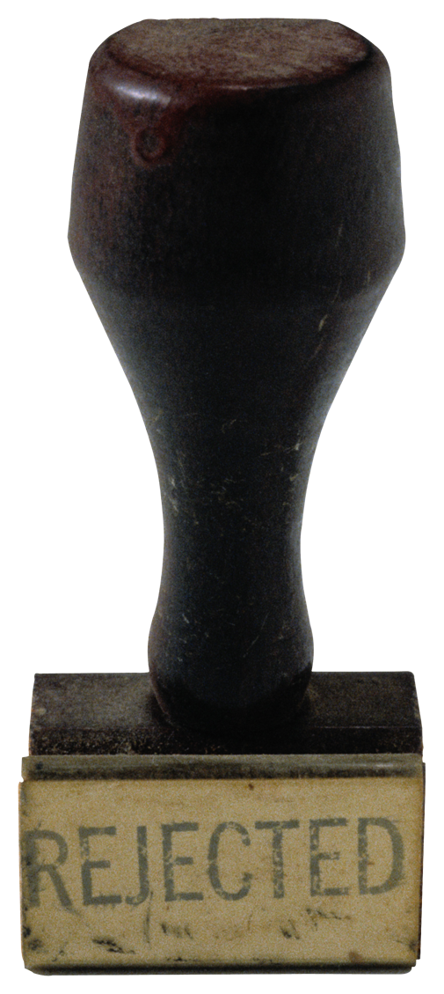
Research & Compliance
Pre-Grant
Proposal
Execution
Data Acquisition
Data Management
Data Sharing
Data Analysis
Post-Grant
Data Archival
Data Disposal
Proposal Prep
Budget
Proposal Funded
Preliminary Investigation/IRB
Cyberinfrastructure Design
Data Visualization
Data Publishing
Data Simulation
Compliance in research means following the data through its entire research lifecycle and managing cyber risk comprehensively. This includes both the user and the IT provider end.
= Involves
compliance
May involve
HPC/Research Computing

Slide 85
Managing Cyber Risk
= Identify, assess, prioritize, and mitigate risk to information security on an ongoing basis.
Makes you think in terms of managing risk, not just plugging system security holes.
Risk = {Threat/Vulnerability x Likelihood x Impact}
A big threat from an existing vulnerability that is highly unlikely to be exploited or has little impact is low risk. You don’t kill yourself over it.

Slide 86
Risk Assessment
... is like the air you breathe in the information security risk management world. You cannot manage risk without first assessing it.
There are many ways to assess risk, ranging all the way from pedestrian (& cheap) to highly complex (& expensive).
Your effort should be commensurate with your budget, risk tolerance, and complexity.

Slide 87
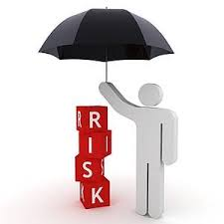
Risk Management Framework
A mature RMF is a complete risk management package. It includes:
Governance = institutional security organization, policies, sanctions, enforcement
Risk management = assessment, mitigation through appropriate physical, administrative, technical controls, documentation
Review = regular monitoring, reviews, assessment, and mitigation
Awareness and training = for both staff and users

Slide 88
Industry Standard RMFs
NIST RMF = National Institute of Standards and Technology RMF
DIACAP = Dept. of Defense Information Assurance Certification Process
OCTAVE = Operationally Critical Threat, Asset, and Vulnerability Evaluation
HITRUST CSF = Health Information Trust Common Security Framework
FAIR = Factor Analysis of Information Risk
TARA = Threat Agent Risk Assessment

Slide 89
The NIST RMF
Let’s take a detailed look at the NIST RMF.
It will show that the NIST RMF is comprehensive and yet flexible enough to adapt to any environment/scale.
The RMF essentially represents a cybersecurity lifecycle.
The steps are described by NIST and other govt. publications.

Slide 90
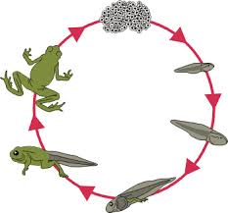
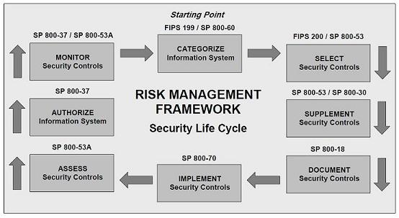
NIST Security Lifecycle

Slide 91
1. Categorize
FIPS 199 (Standards for Security Categorization of Federal Information and Information Systems) helps categorize data based on confidentiality, integrity, and availability.
Categories are Low, Medium, and High.
NIST 800-60 (Guide for Mapping Types of Information and Information Systems to Security Categories) outlines a process for categorization.

Slide 92
FIPS 199 Categorization

Slide 93
2. Select Controls
FIPS 200 (Minimum Security Requirements for Federal Information and Information Systems) ties minimums to the NIST 800-53 controls.
NIST 800-53 (Security & Privacy Controls for Federal Information Systems and Organizations) provides a catalog of security controls. They are divided into control families. Each controls has a baseline and zero or more control enhancements for stricter security.

Slide 94
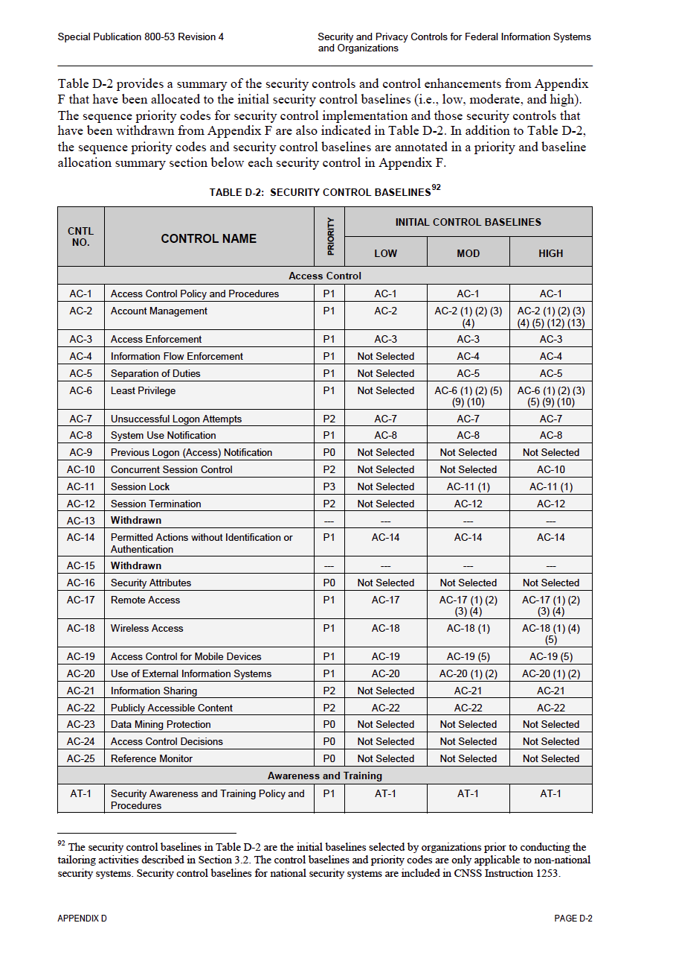
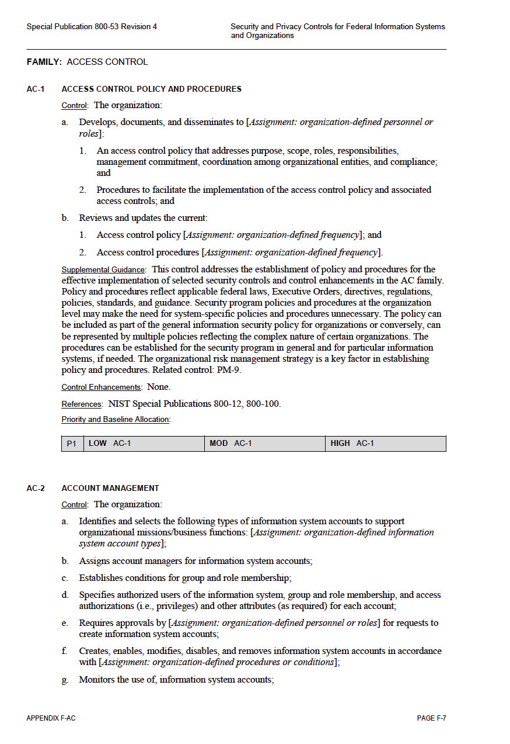
Control Family
Security Baselines
Controls
NIST 800-53

Slide 95
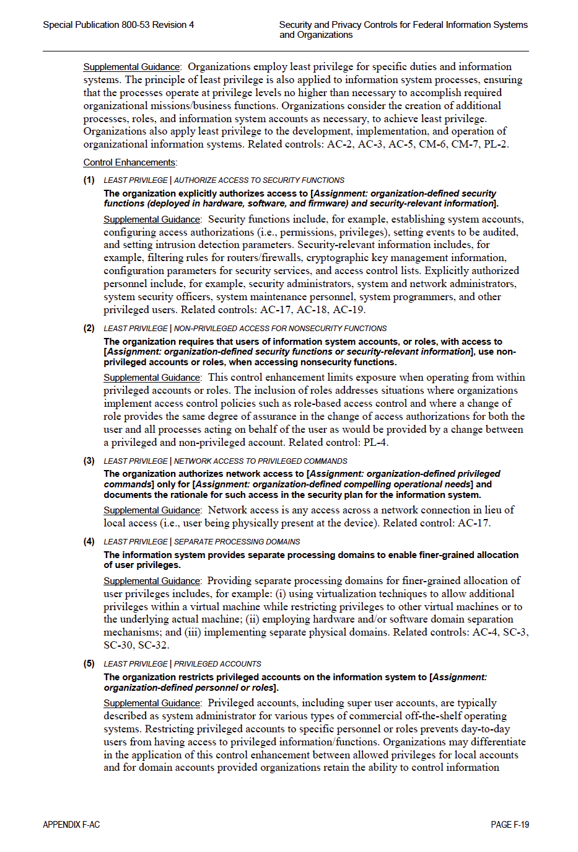
Control Enhancements
Security Baselines

Slide 96
Control Selection
If you are aligning with the NIST Low security baseline, you select from the controls that are in the “LOW” column.
More and more controls must be added as you move to Moderate and High baselines.
FISMA Low, Moderate, and High correspond to the NIST Low, Moderate, and High baselines.
800-53 has 936 total controls, with 16 covering program management, 240 base, and 680 enhancements.

Slide 97
3. Supplement Controls
Controls are supplemented as needed to mitigate risks after a risk assessment identifies them.
NIST 800-30 (Guide for Conducting Risk Assessments) provides the steps to carry out a risk assessment.
NIST risk assessment is based on threat/vulnerability/likelihood/impact determination. It can be as simple or as complex as needed.

Slide 98
NIST Risk Assessment & Response
Step 1: System Categorization
Step 2: Threat Identification
Step 3: Vulnerability Identification
Step 4: Control Analysis
Step 5: Likelihood Determination
Step 6: Impact Analysis
Step 7: Risk Determination
Step 8: Control Recommendations
Step 9: Results Documentation

Slide 99
Risk Assessment/Response Documentation
The risk assessment process is documented in a Risk Assessment report. It describes the methodology used, areas of risk and vulnerabilities, and severity.
The response is documented in what is called the Plan of Action & Milestones (POA&M).
It documents risk response - whether the risk was accepted, mitigated, or transferred to someone else. It also specifies timelines and actions for mitigation as appropriate.

Slide 100
4. Document Controls
NIST 800-18 (Guide for Developing Security Plans for Federal Information Systems) describes what to document how in what is known as the System Security Plan (SSP).
The SSP describes system details and documents every NIST 800-53 security and privacy control currently in place, both base and enhancements.
It is the most voluminous NIST document and requires some knowledge of NIST 800-53..

Slide 101
5. Assess Controls
NIST 800-53A (Guide for Assessing the Security Controls in Federal Information Systems & Organizations) describes how to develop a plan to assess desired security controls.
It helps build assurance into the RMF.
The organization is left to devise the tests that assess the controls. Examples are penetration testing to break into systems, etc.

Slide 102
6. Authorize Information System
NIST 800-37 (Guide for Applying the Risk Management Framework to Federal Information Systems) describes how to leverage the NIST RMF once it is in place. It describes all of the NIST steps in detail.
Authorization is based upon the information in the authorization package, namely the POA&M, the SSP, and the RA report.

Slide 103
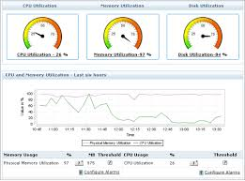
7. Monitor Information System
NIST 800-37 also describes how security controls should be monitored on an ongoing basis for system changes & their impact.
It provides guidance on regular security/risk assessments, remediation, system removal, decommissioning, etc.
Continuous monitoring is an essential requirement of FISMA.

Slide 104
Compliance & Clouds

Slide 105
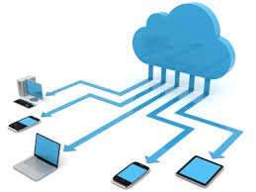
How are we doing?
Both the government and cloud vendors have struggled with compliance.
Most vendors refuse to sign a HIPAA BAA, largely due to liability and/or ignorance. Fortunately, the majors - AWS, Microsoft, Box, etc. - will now sign.
There is also a program called FedRAMP that a cloud vendor can go through to comply with FISMA. It is not easy!

Slide 106
HIPAA in the Cloud
It is finally possible to use the cloud to store or process ePHI.
We have just subjected Box to a HIPAA assessment and will soon allow researchers to use it for ePHI.
Most cloud vendors are simply choosing to encrypt all data at rest and in transit to lower risk.
There are also vendors who will provide a HIPAA “compliant” hosting environment.

Slide 107
5. Building & Leveraging a Risk Management Framework

Slide 108
Where to start?
At first glance, HIPAA and FISMA seem highly onerous.
Digging deeper shows that this is not necessarily true.
Because you already have many components of a RMF in place (whether or not you realize it).
This becomes clear when you start taking stock
If you don’t believe it, let me prove it to you.

Slide 109
Pre-existing RMF Components
Administrative controls - institutional policies & procedures, disaster recovery, incident response, workforce security, training, etc.
Physical controls – secure data center, etc.
Technical controls – access control, account management, logging, patching, backups, encryption (ssh, https), firewalls, monitoring, etc.
Documentation

Slide 110
Choosing a RMF
You can choose from any number of cybersecurity RMFs available these days.
FAIR is a good one at modest scales.
OCTAVE provides an organizational RMF.
NIST is good for HIPAA and especially good if you are considering FISMA.
We chose NIST because pretty much any govt. or other rule/regulation can be mapped to NIST.

Slide 111
Building the RMF at IU
The only real world RMF we can illustrate is ours.
It is NIST based and is used to handle HIPAA currently.
We hope to use it for FISMA and other rules and regulations going forward.
The idea is to create a standards based foundation for all cyber compliance at IU.
The project started about a year ago, took 1 FTE, and completed recently.

Slide 112
IU’s NIST RMF Implementation
Our NIST implementation is lightweight and nimble – we decided to start simple and align with the NIST Low security baseline.
Any control enhancement we already have or institute is added as icing on the cake.
The NIST process has been adapted to our needs. It does not literally follow everything in the NIST docs. Instead, it follows the NIST spirit of managing risk.

Slide 113
Aligning with NIST at IU
1. Inventory
2. Documentation
3. Risk Self-Assessment
4. Risk Response
5. Training
6. Oversight & Approval
7. Authority to Operate
8. Ongoing Risk Management

Slide 114
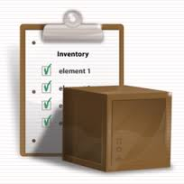
1. Inventory
System details, ePHI location, security settings, BAAs, scan info, access methods, disposal information, etc.
Software, version, patch level, BAAs, scan info, etc.
Privileged access inventory - names, roles, dates authorized, etc.
Incident log – incident summary, response.

Slide 115
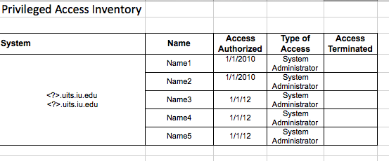
The Inventory

Slide 116
2. Controls -The SSP
We based our SSP on the templates used by DHHS, NASA, etc. use to satisfy FISMA.
It specifies system name, categorization, contacts, purpose, diagram, component description, interconnections, boundaries, dependencies, and a complete catalog of NIST 800-53 security & privacy controls in place.
Enterprise common controls addressing each NIST 800-53 control family are documented separately and referenced in the SSP.

Slide 117
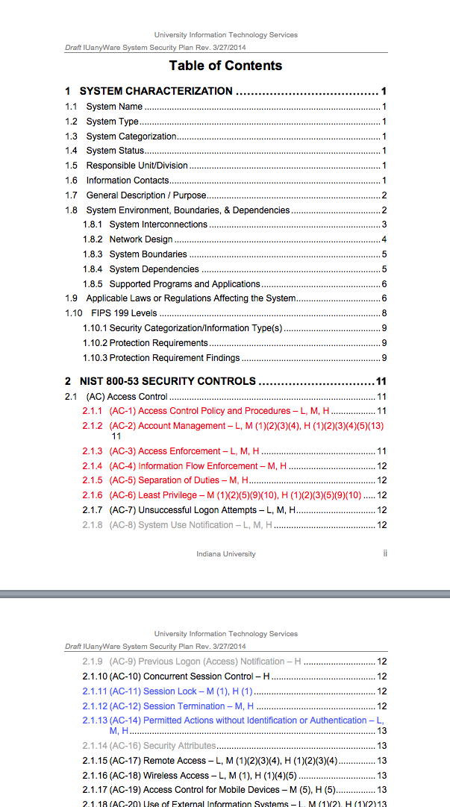
The SSP
HIPAA “required” & “addressable” controls are
color coded

Slide 118
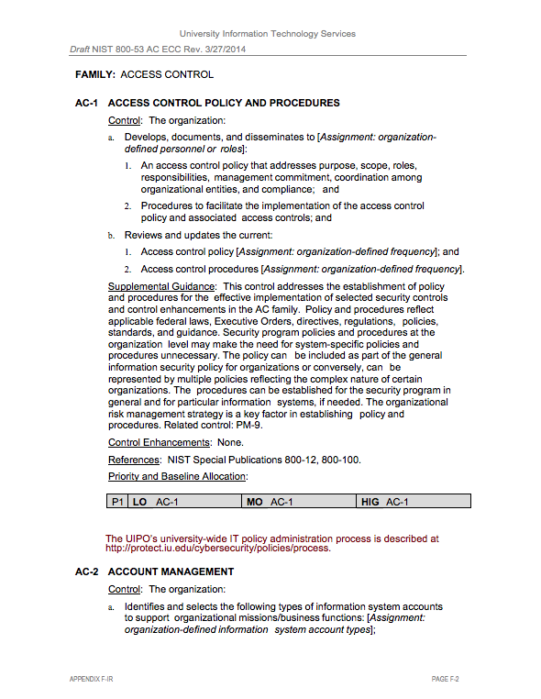
The Enterprise CommonControls

Slide 119
Secure the documents
Once you create compliance documentation, it becomes an asset that needs protecting
Secure documentation management is key.
Centralizing documentation helps with this.
Encrypting documents helps too.
We require an NDA if an external entity (customer, vendor, etc.) wants to see our documents.
HIPAA compliance document retention = 6 years.

Slide 120
3. The RA Report
We do risk self-assessments.
Managers & sys admins brainstorm and identify areas of vulnerabilities and risk for the system.
The assessment documents risk areas, NIST controls that address those risks, residual vulnerabilities and risks, and risk severity.
External, third party assessments are performed every five years.

Slide 121
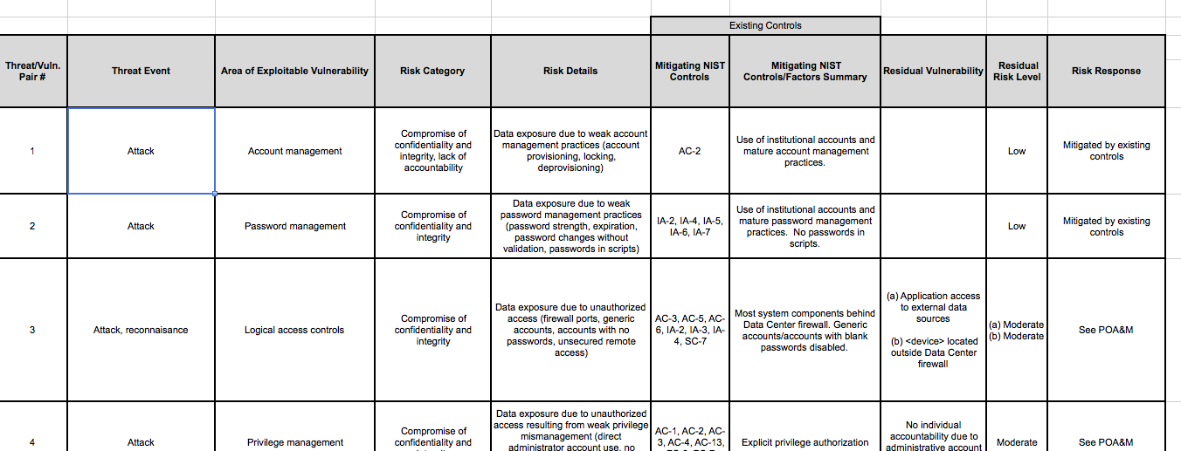
The RA Report

Slide 122
4. Response - POA&M
Our Plan of Action & Milestones documents our response to the residual risks that are not addressed by the existing controls.
The response includes things like whether the risk was accepted or transferred, reasons, time estimate and activities planned if mitigation is planned, etc.
It is not possible always to respond to a risk due to budget, technology constraints, etc. We document this and try our best to address those using training or workarounds.

Slide 123
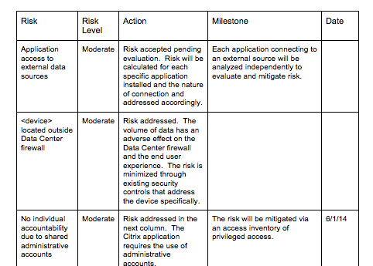
The POA&M

Slide 124
5. Staff Training
Annual training is mandated for all who are involved in the care and feeding of the system (both management and staff).
Three e-training modules must be completed:
The standard IU HIPAA training (covering the reg and IU policies & procedures)
IU Human Subjects training
UITS specific information on how HIPAA applies to us, our policies & NIST procedures
All security related is documented in a training log.

Slide 125
User Training
All security measures at the back end can be defeated by security challenged users. They are typically the weakest link in the chain.
We address this risk by providing guidance in our Knowledge Base about what is and is not permitted when handling ePHI on our systems.
As we work individually with researchers, we train them & help them create HIPAA documentation that describes how they are protecting their end.

Slide 126
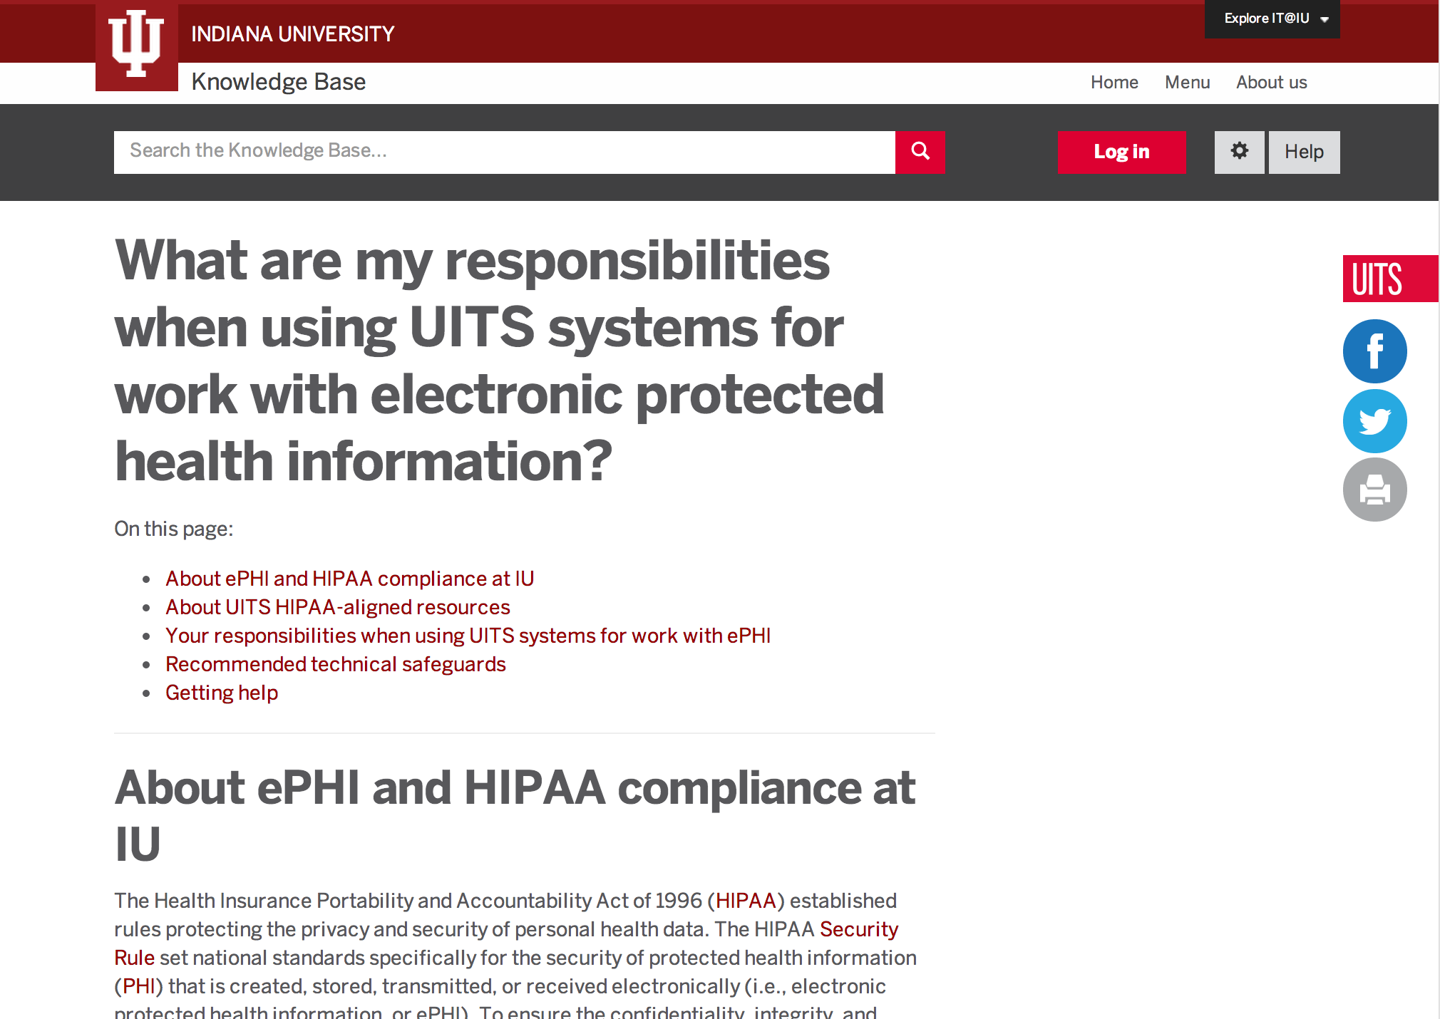
User awareness and training

Slide 127
6. Oversight
When ready, the compliance package is sent to the IU HIPAA Privacy and Security Office, the University Information Security Office, and Internal Audit.
We’d like every system under alignment to go through a full assessment but this is not done today due to (a) lack of resources, and (b) the trust that we have developed by working closely with these partners.
Critical systems do get assessed.

Slide 128
7. Authority to Operate
After we have reviewed everything and have approval from the partners, we issue an ATO.
The ATO is good for thee years.
Renewal requires a review of ongoing risk management practices, training, any incidents that may have occurred, response, etc.
The ATO is a vehicle for a unit to self-assert compliance with oversight from us.

Slide 129
8. Ongoing Risk Management
Once a system comes under alignment, it becomes subject to regular, ongoing risk management. This includes:
Semi-annual reviews, risk re-assessments, and documentation updates.
Continuous & automatic monitoring of risks, systems, generating alerts.
Annual training
Oversight
External assessments every five years

Slide 130
From NIST to HIPAA
NIST 800-66 (An Introductory Resource Guide for Implementing the HIPAA Security Rule) provides HIPAA to NIST mapping.
Our System Security Plan contains a HIPAA section that addresses HIPAA requirements that do not map to NIST.
We will do the same for other rules and regulations such as IU’s critical data requirements, etc.

Slide 131
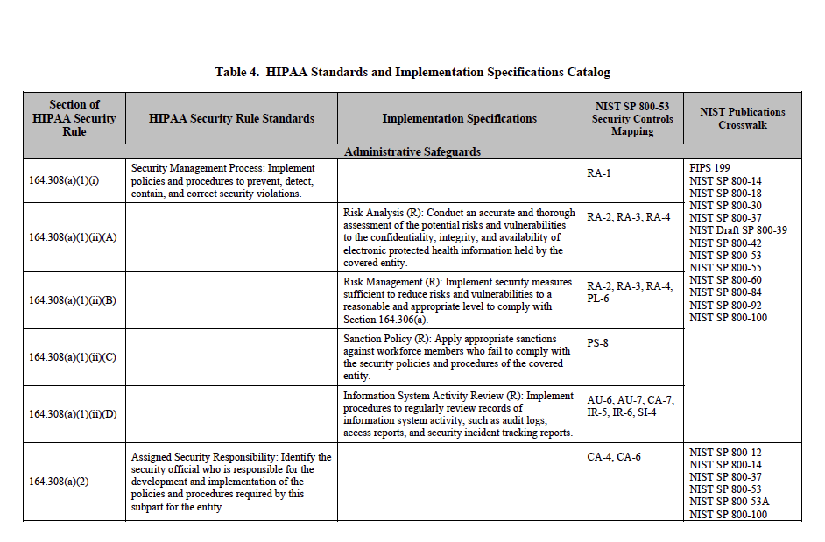
NIST 800-66 HIPAA to NIST Crosswalk

Slide 132
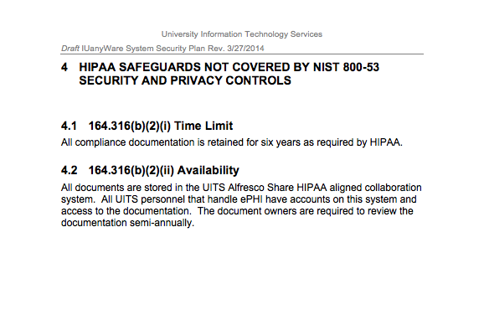
IU SSP Section addressing HIPAA

Slide 133
This shows how a NIST RMF provides an effective way to manage compliance

Slide 134
Current Status
At IU, we are establishing institutional processes for HIPAA/FISMA & IT compliance generally.
HIPAA is in place for central HPC/IT.
FISMA is in process.
Like a lot of other places, the IU GRC (Governance, Risk, Compliance) framework is in flux and evolving. We are plugged into the thick of it due to effective partnerships.

Slide 135
Institutional HIPAA Process
1. Researcher needs HIPAA compliant IT solution
2. IU HIPAA Compliance Office, etc. sends them to us
3. We help build a HIPAA aligned solution
4. We help with documentation
5. Documentation is submitted to the ISO, Internal Audit, and HIPAA Compliance
6. The researcher self-asserts HIPAA compliance

Slide 136
Institutional FISMA Process*
1. Researcher gets/renews a govt. contract
2. Office of Research Admin (ORA) contacts us
3. We help build and monitor FISMA compliance
4. We help create a FISMA “package” for ORA
5. PI/ORA submit the package to agency
6. Agency issues an ATO
* = Future

Slide 137
Compliance is no beast
The government does not expect you to undertake herculean measures or build walled gardens.
Rules and regulations affecting cybersecurity are about using best practices, something we should be doing anyway.
All of us have sufficiently good cybersecurity in place already. It won’t take a gargantuan effort to go all the way.

Slide 138
Future
Expand the mature, standards-based NIST approach to all IT compliance at IU.
Provide NIST-based risk and security assessment tools to all IT units for internal assessments.
Centralize documentation which can be used by all units conducting IT assessments (UISO, Internal Audit).
Create/modify policies to be aligned with NIST.

Slide 139
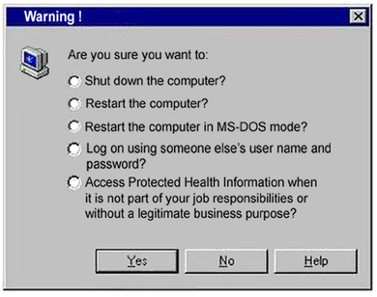
Vision
Establish an online risk profile system which automatically checks for new vulnerabilities, laws, etc. and provides alerts. We update the profile continuously as risks change.
Institute central support for all IT related compliance.
We’d like to build compliance into the very fabric of our IT environment.

Slide 140
6. Conclusions

Slide 141
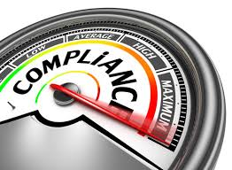
Compliance is Imminent
Biomedical research is on a collision course with the HPC/research computing world.
An increasingly larger volume of ePHI can be expected to land on academic HPC systems.
Grants and contracts will be requiring FISMA ‘compliance’.
It is coming, so embrace it.

Slide 142
Opportunities and Threats
Not having a compliance process in place means missed opportunities, particularly for ‘Big Data’ applications in health sciences research.
Managing ePHI without a RMF in place creates institutional liability and damage reputation.

Slide 143
Benefits
A standards based RMF implementation aligns with other/future regulations, and can be part of an institutional risk management strategy.
Customers with sensitive data will develop trust and bring new business.
Your compliance folks will send people your way (ours do).
You will better serve all your researchers.

Slide 144
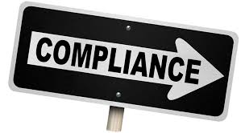
You’re well on your way to compliance already!
The government does not expect us to undertake herculean measures or build walled gardens.
These regulations are about using best practices, something we should be doing anyway.
All of us have sufficiently good information security in place already.

Slide 145
HIPAA/NIST Resources
The HIPAA Security Rule
http://www.hhs.gov/ocr/privacy/hipaa/administrative/securityrule/index.html
NIST 800-66: Guide to Implementing the HIPAA Security Rule
http://csrc.nist.gov/publications/nistpubs/800-66-Rev1/SP-800-66-Revision1.pdf
NIST 800-53: Recommended Security Controls
http://csrc.nist.gov/publications/nistpubs/800-53-Rev3/sp800-53-rev3-final_updated-errata_05-01-2010.pdf
NIST 800-53A: Guide for Assessing Security Controls
http://csrc.nist.gov/publications/nistpubs/800-53A-rev1/sp800-53A-rev1-final.pdf
FIPS 200: Federal Systems Minimum Security Requirements
http://csrc.nist.gov/publications/fips/fips200/FIPS-200-final-march.pdf
NIST HIPAA Security Rule Toolkit
http://scap.nist.gov/hipaa/
IU NIST templates (email Anurag)

Slide 146
Contact
Anurag Shankar ashankar@iu.edu
Bill Barnett
barnettw@iu.edu

Slide 147
License Terms
Please cite as: Barnett, W. and A. Shankar, HPC, HIPAA, and FISMA: Meeting the Regulatory Challenge through Effective Risk Management, presented at 2014 NSF Cybersecurity Summit for Large Facilities and Cyberinfrastructure, 2014.
Items indicated with a © are under copyright and used here with permission. Such items may not be reused without permission from the holder of copyright except where license terms noted on a slide permit reuse.
Except where otherwise noted, contents of this presentation are copyright 2014 by the Trustees of Indiana University.
This document is released under the Creative Commons Attribution 3.0 Unported license (http://creativecommons.org/licenses/by/3.0/). This license includes the following terms: You are free to share – to copy, distribute and transmit the work and to remix – to adapt the work under the following conditions: attribution – you must attribute the work in the manner specified by the author or licensor (but not in any way that suggests that they endorse you or your use of the work). For any reuse or distribution, you must make clear to others the license terms of this work.

