Slide 1
Security Best Practices for Academic Cloud Service Providers
Rion Dooley, Andy Edmonds, David Y. Hancock, Richard Knepper, John Michael Lowe, Edwin Skidmore, Andrew K. Adams, Ryan Kiser, Mark Krenz, Von Welch
Notes:
A “cloud resource” provides a hosted, self-service means for users to run virtual machines or containers such that they can have a custom software stack and isolation from other users. Virtual machines or container images can be curated and provided by the cloud resource operator, provided by the user, or provided by third parties.
Operating a cloud resource involves addressing security requirements of multiple stakeholders: those of the resource operator and those of the resource user. These parties may have different incentives related to security as well as different levels of acumen. Operators may at times run images whose trustworthiness is not established and grant users privileged access within their running image that would be uncommon on non-virtualized computing resources. Moreover, users, with their elevated privileges, can misconfigure services, expose sensitive data or choose protocols/solutions that offer less security for the sake of installation or operating costs. These factors can lead to an environment that, by its nature, is difficult to secure.
A community consisting of The Agave Platform, Cornell University Center for Advanced Computing, CyVerse, Jetstream and Trusted CI collaborated in authoring a set of Security Best Practices for developing in, and operating an academic cloud resource. The effort in tackling the unique security risks to academic cloud services was guided by three basic principles, specifically: security is a shared concern between a cloud service provider and a cloud service user, neither can expect the other to fully address security; a clean delineation between cloud service provider and cloud service user of security responsibilities is critical to ensure all responsibilities are met; and the cloud service provider has the responsibility to ensure all security responsibilities are articulated and the cloud service user is educated about how to fulfill their responsibilities.
In the document at http://hdl.handle.net/2022/22123, the community details nine use cases they deemed most important to academic cloud services, exploring the security concerns of each, as well as providing one or more security best practices that balance the needs of the stakeholders and mitigates risk. The nine use cases are:
Disseminate Localized Best Practices
Ensure Image Trustworthiness
Provide Method to Manage User Secrets
Support Privileged Access within Images
Empower Users with Self-service DNS Management
Provide Method to Manage User Configurations
Provide Service Accounts
Offer Monitoring Services
Offer Identity and Access Management-aware Continuous Integration / Continuous Delivery Services
Members of the community, including, Rion Dooley, Richard Knepper and Mike Lowe would like to present both their experiences in developing this set of Security Best Practices, as well as the state of academic cloud services and the direction the community needs to push for in order to meet the demands of science. The community leaders request a plenary sessions of sixty minutes in order to relate their experiences.

Slide 2
Stakeholders
Cloud resource providers
Cloud service providers
Academic cyberinfrastructure providers
Users
Notes:
Academic Cloud Resource/Service Providers: providers of cloud services to the community. Atmosphere (http://www.cyverse.org/atmosphere), HUBzero (https://hubzero.org/), Jetstream (https://jetstream-cloud.org/), RedCloud (https://www.cac.cornell.edu/services/cloudservices.aspx), and science gateways are examples of Academic Cloud Resouce/Service Providers. Examples of general security concerns that may affect them, include 1. Loss/failure of operational dependencies, 2. Increased exposure to vulnerabilities, 3. Ineffective or untimely incident response/analysis, 4. Loss/exposure of user data within images due to factors within provider’s purview, and 5. Loss of reputation (see Appendix A).
Academic CI (Cyberinfrastructure) Providers: developers of infrastructure (typically software) which is integrated by Resource/Service Providers into their services. Agave (https://agaveapi.co/), Cyverse (http://www.cyverse.org/), Galaxy (https://galaxyproject.org/cloud/), Globus (https://www.globus.org/), an SciGaP (https://scigap.org/) are examples of Academic CI Providers. Example security concerns that affect these types are 2. Increased exposure to vulnerabilities, 3. Ineffective or untimely incident response/analysis, 4. Loss/exposure of user data within images due to factors within provider’s purview, and 5. Loss of reputation (see Appendix A).
Users: researchers and others using cloud infrastructure, including, researchers, image providers, external users who may be impacted by activities within an image. Example security concerns that impact Users are 1. Loss or unpredictability of services/performance, 2. Loss/exposure of secrets & sensitive/embargoed data, and 3. Loss of reputation (see Appendix B).

Slide 3
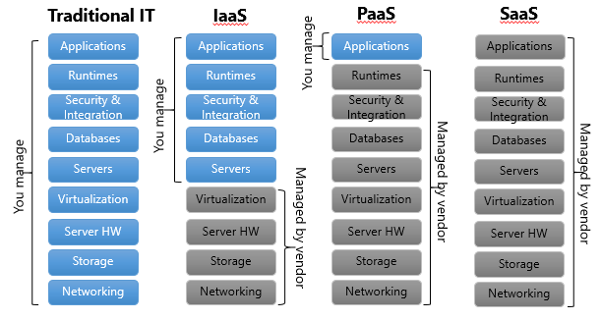
Scope
IaaS
PaaS
Saas
Notes:
Academic Cloud Resource/Service Providers: providers of cloud services to the community. Atmosphere (http://www.cyverse.org/atmosphere), HUBzero (https://hubzero.org/), Jetstream (https://jetstream-cloud.org/), RedCloud (https://www.cac.cornell.edu/services/cloudservices.aspx), and science gateways are examples of Academic Cloud Resouce/Service Providers. Examples of general security concerns that may affect them, include 1. Loss/failure of operational dependencies, 2. Increased exposure to vulnerabilities, 3. Ineffective or untimely incident response/analysis, 4. Loss/exposure of user data within images due to factors within provider’s purview, and 5. Loss of reputation (see Appendix A).
Academic CI (Cyberinfrastructure) Providers: developers of infrastructure (typically software) which is integrated by Resource/Service Providers into their services. Agave (https://agaveapi.co/), Cyverse (http://www.cyverse.org/), Galaxy (https://galaxyproject.org/cloud/), Globus (https://www.globus.org/), an SciGaP (https://scigap.org/) are examples of Academic CI Providers. Example security concerns that affect these types are 2. Increased exposure to vulnerabilities, 3. Ineffective or untimely incident response/analysis, 4. Loss/exposure of user data within images due to factors within provider’s purview, and 5. Loss of reputation (see Appendix A).
Users: researchers and others using cloud infrastructure, including, researchers, image providers, external users who may be impacted by activities within an image. Example security concerns that impact Users are 1. Loss or unpredictability of services/performance, 2. Loss/exposure of secrets & sensitive/embargoed data, and 3. Loss of reputation (see Appendix B).

Slide 4
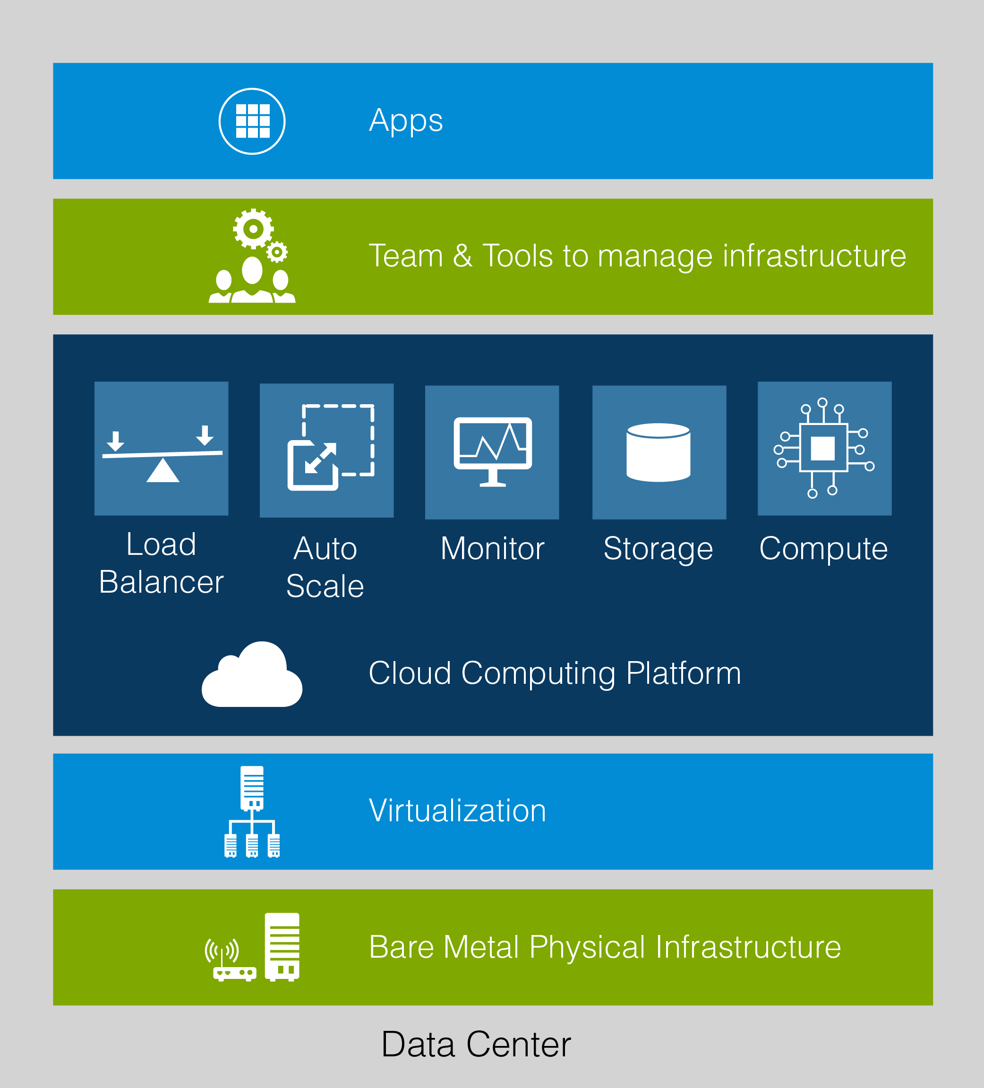
Scope
Gateways, web apps, web services, etc
Orchestration, db, queues, registries, config mgmt.
Storage, compute, load balancing, provisioning, networking, IAM
Hypervisor, cloud management
Rack and stack
Power and cooling
Notes:
This document focuses only on those academic organizations and projects that host and develop the system infrastructure for providing access to host virtualization technologies at the hardware or operating system level, including, Infrastructure-as-a-Service (IaaS), Platform-as-a-Service (PaaS) and Science-as-a-Service (SaaS) services.
The focal point of this document also encompasses the organizational processes and policies in managing and securing these technologies.
It is a list of recommendations for security best practices within an academic cloud service provider, but the document is not intended to provide an exhaustive list, rather to identify and address those practices unique to cloud services provided in an academic or research environment.

Slide 5
Participants

Slide 6
Terms of engagement
Security is a shared concern between a cloud service provider and a cloud service user, neither can expect the other to fully address security.
A clean delineation between cloud service provider and cloud service user of security responsibilities is critical to ensure all responsibilities are met.
The cloud service provider has the responsibility to ensure all security responsibilities are articulated and the cloud service user is educated about how to fulfill their responsibilities.

Slide 10
The Recommendations
Disseminate Localized Best Practices
Ensure Image Trustworthiness
Provide Method to Manage User Secrets
Support Privileged Access within Images
Empower Users with Self-service DNS Management
Provide Method to Manage User Configurations
Provide Service Accounts
Offer Monitoring Services
Offer Identity and Access Management-aware Continuous Integration / Continuous Delivery Services
Notes:
Disseminate Localized Best Practices
Provide best practice documents and support services regarding the issues identified in this use case:
Detect common patterns of misbehavior so that users can be alerted and educated
Ensure Image Trustworthiness
Image registries
Sign, scan, ACL, API, UI, Tagging/Flagging
Provide Method to Manage User Secrets
* Secret managers
Support Privileged Access within Images
Limit image functionality via the network
Network monitoring, passive or active
Empower Users with Self-service DNS Management
Automatic DNS record generation
DNS as a Service
Provide Method to Manage User Configurations
Provide configuration managers
Provide Service Accounts
Service accounts
Offer Monitoring Services
Provide an interface to existing monitoring solutions for users to access
Provide notification of infrastructure service outages
Offer Identity and Access Management-aware Continuous Integration / Continuous Delivery Services
Offer hosted, multi-tenant CI/CD services

Slide 11
Download the Official white paper
http://hdl.handle.net/2022/22123

Slide 12
Thank you

